Slide 1

PowerBI Project Presentation
Customer Churn Analysis
A Data-Driven Approach to Understanding Customer Behavior & Reducing Churn
PRESENTED BY: D.ANJALI
INNOMATICS RESEARCH LABS,

Slide 2
Business Problem:
Telecom companies face high customer churn, leading to significant revenue loss. company lacks visibility into key churn drivers such as contract type, service usage patterns, customer demographics, and service add-ons, making it difficult to take preventive actions and retain high-value customers.
Objective:
To develop an interactive Power BI analytics solution that:
Identifies customer churn patterns
Analyzes demographic, service-level, and billing-based factors
Measures churn rate, revenue impact, and risk distribution
Highlights high-risk segments
Supports data-driven decisions to reduce churn and improve customer retention

Slide 3
Data source:
Dataset Used: Telecom Customer Churn Dataset
Source Format: CSV File
No.of Records: 7043 customers
No.of Columns: 21 data fields
Key Data Fields:
CustomerID - unique identifier for each customer
Gender, SeniorCitizen, Partner, Dependents - demographic features
Tenure - number of months customer stayed
PhoneService, InternetService, OnlineSecurity, etc. - service usage details
PaymentMethod, Contract, PaperlessBilling - billing preferences
MonthlyCharges, TotalCharges - financial indicators
Churn - target variable (Yes/No)

Slide 4
Data Preparation:
Imported dataset into Power BI Desktop
Performed cleaning in Power Query
1.Removed duplicate records
      2. Corrected data types (e.g., TotalCharges → Decimal Number)
      3. Handled missing values
      4.Created Tenure group col
      5.converted Boolean fields to yes/no
Data Model:
Star schema
Fact: Customer Table
Dimensions:
Relationship: one-to-many

Slide 5
Dashboard Visualizations:
1.Customer Demographics :
Visuals used:
Pie chart – Total customer by Gender
Column chart – Total customer by Tenure group
Line chart – Average monthly charges by Tenure
Donut chart – Churned customer by Senior citizen
Bar chart – churn rate by Tenure group
Bar chart – Monthly charges by Tenure group and Gender
Analysis:
Total Customers: 7032 | Churned: 1869 → Churn Rate: 26.6%
Customers with longer tenure are more loyal, while new customers churn more
Higher monthly charges are associated with higher churn rates
Most customers are non-senior citizens, but seniors have a higher churn proportion
Revenue is driven mainly by loyal customers who stay longer.
Male and female customers show almost equal churn and revenue contribution.

Slide 6
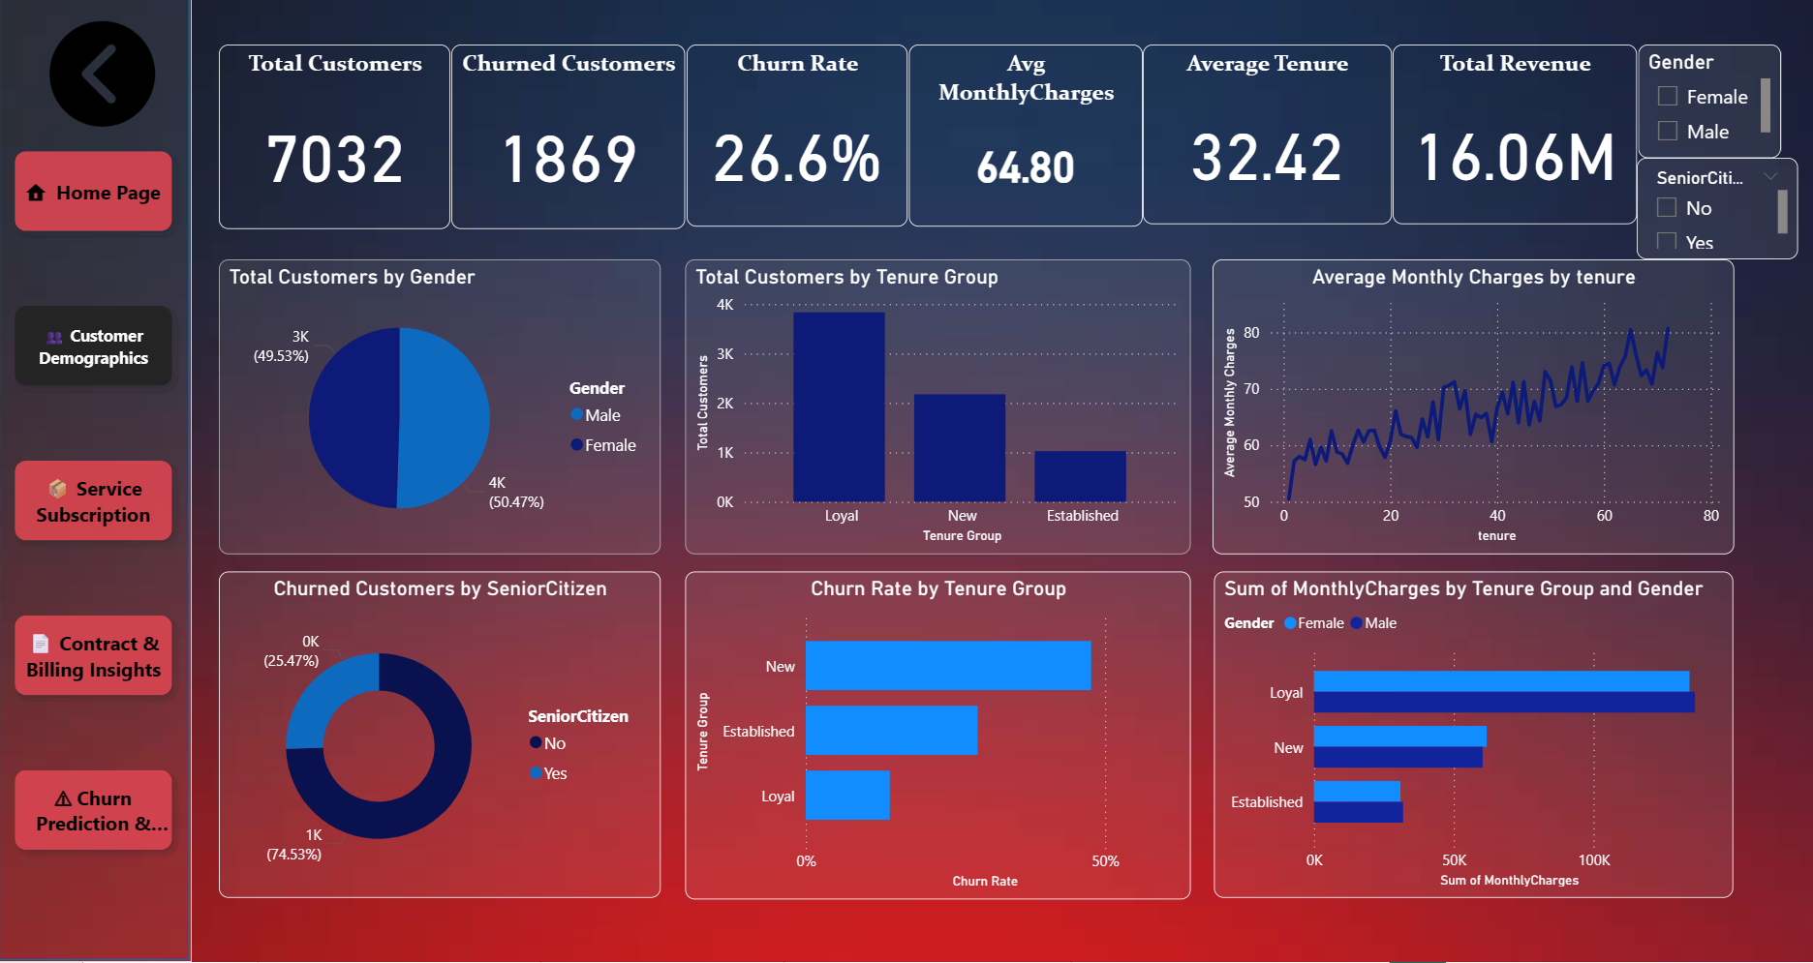

Slide 7
2.Service Subscriptions:
Visuals used:
Column chart – Total customer by PhoneService
Scatterplot – Service usage pattens among churn customers
Line and clustered column chart – Total customers and churn rate by internet service
Column chart – Churn rate and churned customers by internet service
Column chart – Churn rate by service count
Bar chart – Total customers by service count
Slicer – Customer service adoption and churn insights based on gender and service type
Analysis:
Phone service is widely used → ~6.4K customers rely on it as a primary service
Fiber optic users churn the most (≈42%) despite high user base — pricing/service issues
DSL customers show lower churn (≈19%) — more satisfaction/stability
Customers without internet service rarely churn (≈7%) — internet-related dissatisfaction is a key
churn driver
Higher monthly charges + lower tenure = higher churn risk
Churn reduces as service count increases → Bundled plans improve retention
Most customers choose mid-level service packages → Opportunity to promote higher bundles

Slide 8
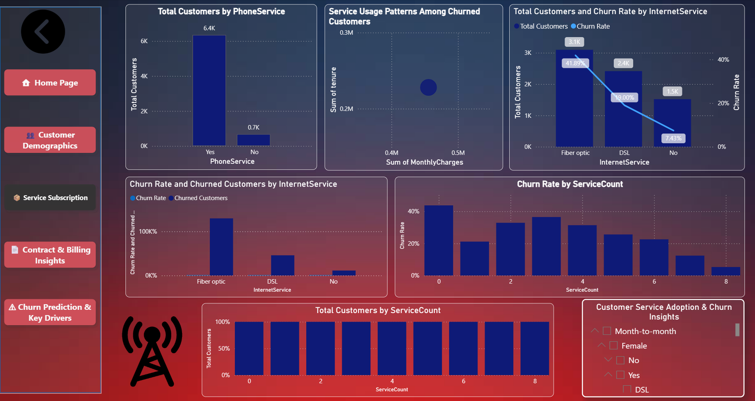

Slide 9
3.Contract & Billing Insights:
Visuals used:
Column chart – Churn rate by contract
Donut chart – Average Total charges by Contract
Column chart – churned customer by payment method
Pie chart – churned customer by paperless billing
Column chart – Sum of monthly charges by payment method
Bar chart – Count of contract by tenure group
Analysis:
Churn rate is high (26.58%), mainly coming from Month-to-Month contract customers.
Long-term contract customers (1–2 year) churn much less → better loyalty with commitment.
Electronic Check users have the highest churn, suggesting payment convenience impacts retention.
Automatic payments (bank/credit card) show lower churn → smooth billing keeps customers satisfied.
Most revenue is generated from Two-Year contracts, and these customers remain loyal longer.
Customers with short tenure churn the most, highlighting the need for better onboarding and engagement
early.

Slide 10
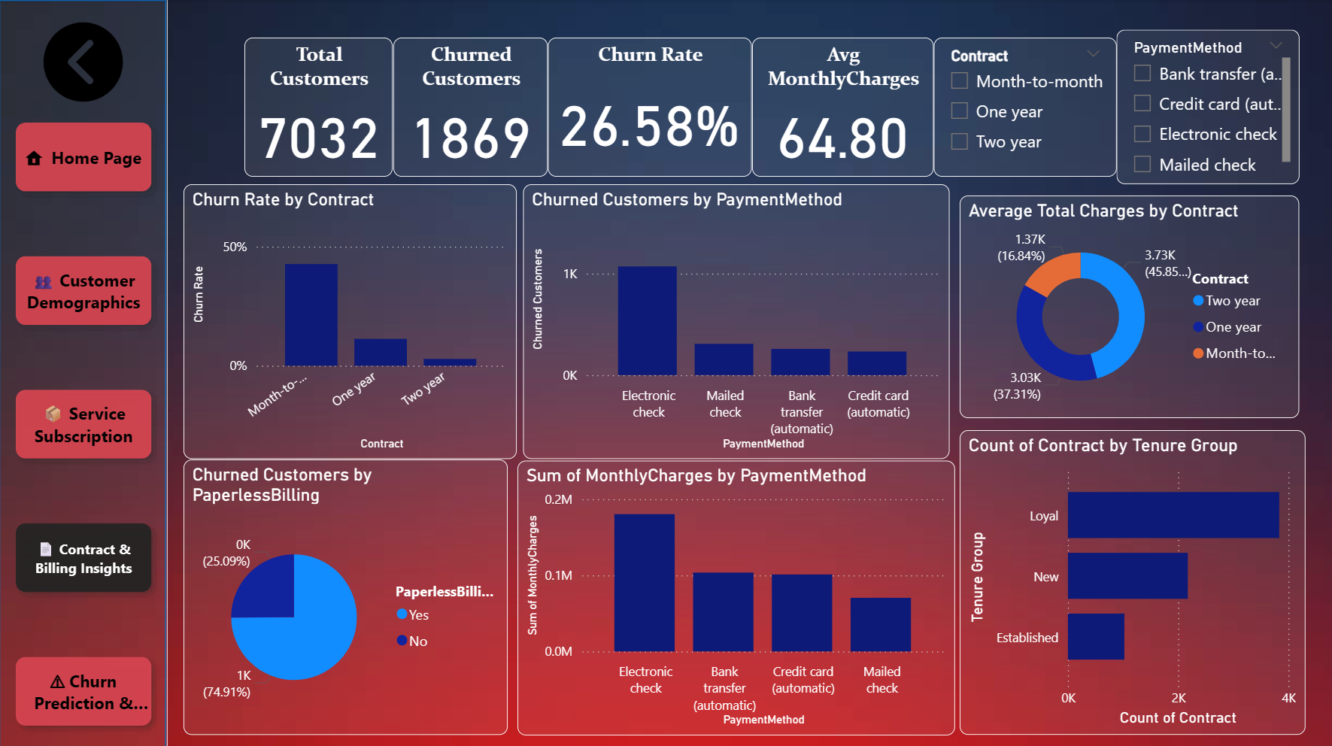

Slide 11
4.Churn Prediction & Key Drivers:
Visuals used:
Stacked column chart – Churn VS Usage
Column chart – Total revenue by churn
Stacked area chart – Churn by segment by payment method, contract and online backup
Matrix - Churn Percentage by Service & Payment Method
Analysis:
The churn rate is 26.6%, with 1,869 customers lost, leading to major revenue impact.
Non-churned customers generate most revenue, showing the value of retention.
Month-to-month contracts show the highest churn, while long-term contracts retain customers better.
Electronic Check users show the highest churn, indicating payment method issues.
Customers with more services and higher monthly charges are less likely to churn.
The churn matrix shows Fiber Optic + Electronic Check users have the highest churn, while customers
without internet service churn the least.

Slide 12
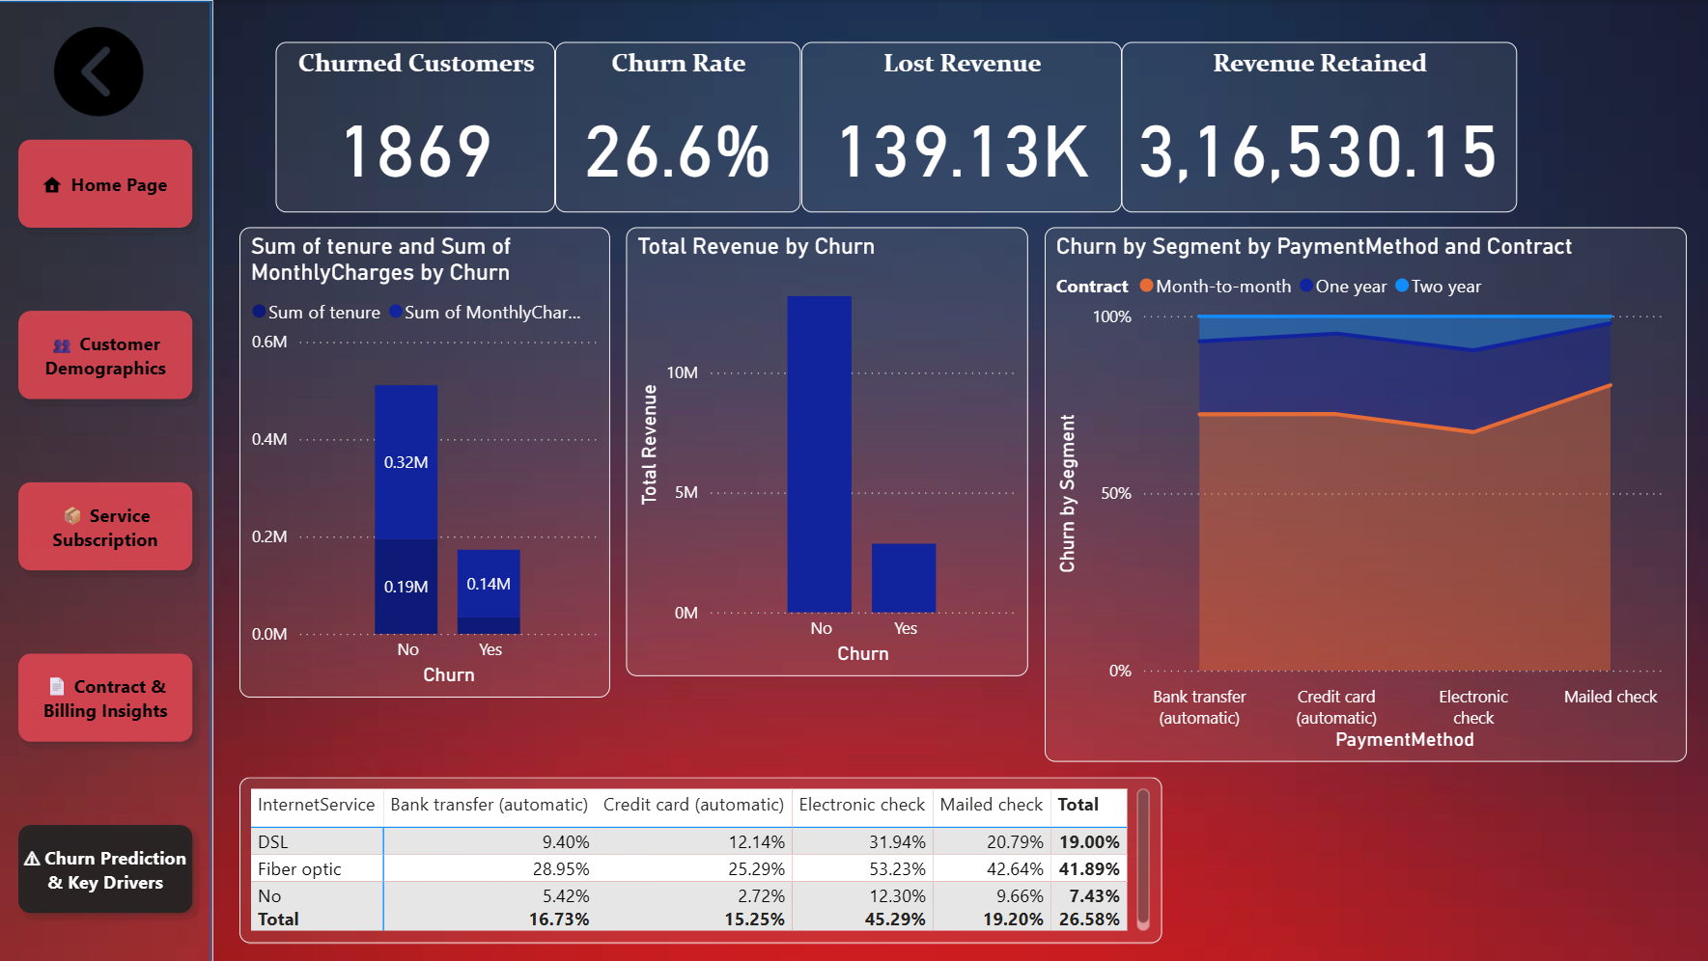

Slide 13
Churn Drivers:
Month-to-month contracts show the highest churn.
Electronic check users churn more due to billing issues.
High monthly charges create price sensitivity.
Fiber Optic users churn the most among service types.
Low tenure customers leave early due to weak initial experience.
Customers using fewer services are less engaged and more likely
to churn.
Conclusion:
Overall, churn is driven by a combination of short contracts, inconvenient payment methods, high pricing, and low customer tenure. Improving long-term plans, simplifying billing, engaging new customers early, and enhancing service quality—especially for Fiber Optic users—can significantly reduce churn and increase revenue stability.

Slide 14

THANK YOU

